Slide 1
Chapter 10: File-System Interface

Slide 2
Chapter 10: File-System Interface
File Concept
Access Methods
Directory Structure
File-System Mounting
File Sharing
Protection

Slide 3
Objectives
To explain the function of file systems
To describe the interfaces to file systems
To discuss file-system design tradeoffs, including access methods, file sharing, file locking, and directory structures
To explore file-system protection

Slide 4
File Concept
Contiguous logical address space
Types:
  Data
    numeric
    character
    binary
  Program

Slide 5
File Structure
None - sequence of words, bytes
Simple record structure
  Lines
  Fixed length
  Variable length
Complex Structures
  Formatted document
  Relocatable load file
Can simulate last two with first method by inserting appropriate control characters
Who decides:
  Operating system
  Program

Slide 6
File Attributes
Name – only information kept in human-readable form
Identifier – unique tag (number) identifies file within file system
Type – needed for systems that support different types
Location – pointer to file location on device
Size – current file size
Protection – controls who can do reading, writing, executing
Time, date, and user identification – data for protection, security, and usage monitoring
Information about files are kept in the directory structure, which is maintained on the disk

Slide 7
File Operations
File is an abstract data type
Create
Write
Read
Reposition within file
Delete
Truncate
Open(F_{i}) – search the directory structure on disk for entry F_{i}, and move the content of entry to memory
Close (F_{i}) – move the content of entry F_{i} in memory to directory structure on disk

Slide 8
Open Files
Several pieces of data are needed to manage open files:
  File pointer: pointer to last read/write location, per process that has the file open
  File-open count: counter of number of times a file is open – to allow removal of data from open-file table when last processes closes it
  Disk location of the file: cache of data access information
  Access rights: per-process access mode information

Slide 9
Open File Locking
Provided by some operating systems and file systems
Mediates access to a file
Mandatory or advisory:
  Mandatory – access is denied depending on locks held and requested
  Advisory – processes can find status of locks and decide what to do

Slide 10
File Locking Example – Java API
import java.io.*;
import java.nio.channels.*;
public class LockingExample {
public static final boolean EXCLUSIVE = false;
public static final boolean SHARED = true;
public static void main(String arsg[]) throws IOException {
FileLock sharedLock = null;
FileLock exclusiveLock = null;
try {
RandomAccessFile raf = new RandomAccessFile("file.txt", "rw");
// get the channel for the file
FileChannel ch = raf.getChannel();
// this locks the first half of the file - exclusive
exclusiveLock = ch.lock(0, raf.length()/2, EXCLUSIVE);
/** Now modify the data . . . */
// release the lock
exclusiveLock.release();

Slide 11
File Locking Example – Java API (Cont.)
// this locks the second half of the file - shared
sharedLock = ch.lock(raf.length()/2+1, raf.length(), SHARED);
/** Now read the data . . . */
// release the lock
sharedLock.release();
} catch (java.io.IOException ioe) {
System.err.println(ioe);
}finally {
if (exclusiveLock != null)
exclusiveLock.release();
if (sharedLock != null)
sharedLock.release();
}
}
}

Slide 12

File Types – Name, Extension

Slide 13
Access Methods
Sequential Access
read next
write next
reset
no read after last write
(rewrite)
Direct Access
read n
write n
position to n
read next
write next
rewrite n
n = relative block number

Slide 14
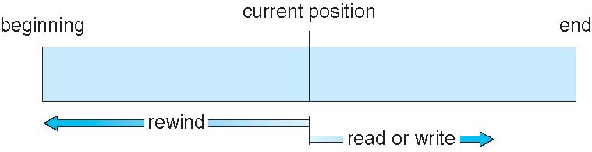
Sequential-access File

Slide 15
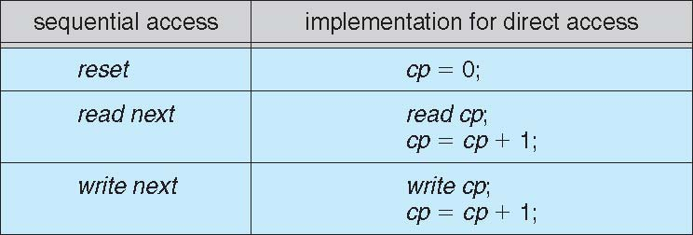
Simulation of Sequential Access on
Direct-access File

Slide 16
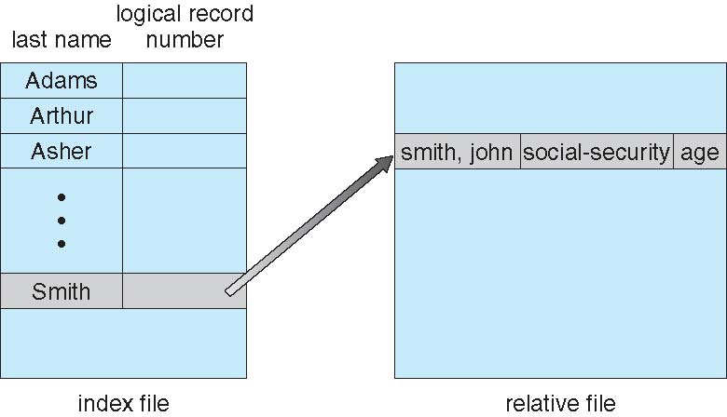
Example of Index and Relative Files

Slide 17
Directory Structure
A collection of nodes containing information about all files
Directory
Files
F 1
F 2
F 3
F 4
F n
Both the directory structure and the files reside on disk
Backups of these two structures are kept on tapes

Slide 18
Disk Structure
Disk can be subdivided into partitions
Disks or partitions can be RAID protected against failure
Disk or partition can be used raw – without a file system, or formatted with a file system
Partitions also known as minidisks, slices
Entity containing file system known as a volume
Each volume containing file system also tracks that file system’s info in device directory or volume table of contents
As well as general-purpose file systems there are many special-purpose file systems, frequently all within the same operating system or computer

Slide 19
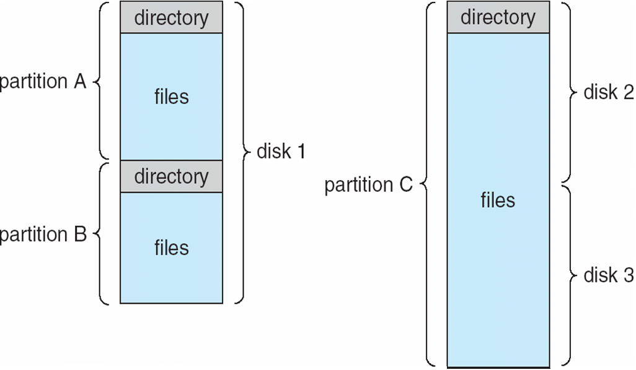
A Typical File-System Organization

Slide 20
Operations Performed on Directory
Search for a file
Create a file
Delete a file
List a directory
Rename a file
Traverse the file system

Slide 21
Organize the Directory (Logically) to Obtain
Efficiency – locating a file quickly
Naming – convenient to users
  Two users can have same name for different files
  The same file can have several different names
Grouping – logical grouping of files by properties, (e.g., all Java programs, all games, …)

Slide 22
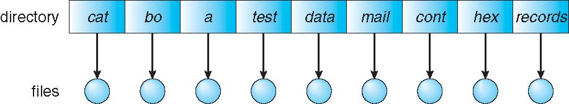
Single-Level Directory
A single directory for all users
Naming problem
Grouping problem

Slide 23

Two-Level Directory
Separate directory for each user
Path name
Can have the same file name for different user
Efficient searching
No grouping capability

Slide 24
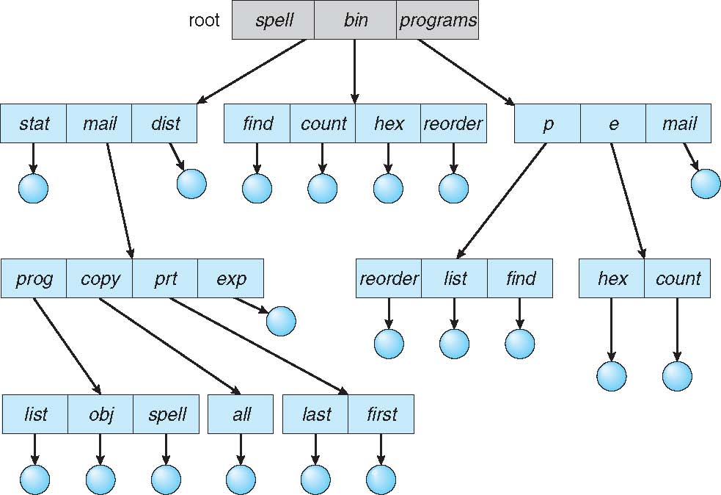
Tree-Structured Directories

Slide 25
Tree-Structured Directories (Cont.)
Efficient searching
Grouping Capability
Current directory (working directory)
  cd/spell/mail/prog
  type list

Slide 26
Tree-Structured Directories (Cont.)
Absolute or relative path name
Creating a new file is done in current directory
Delete a file
rm <file-name>
Creating a new subdirectory is done in current directory
  mkdir <dir-name>
Example: if in current directory /mail
mkdir count
mail
prog
copy
prt
exp
count
Deleting “mail” ⇒ deleting the entire subtree rooted by “mail”

Slide 27

Acyclic-Graph Directories
Have shared subdirectories and files

Slide 28
Acyclic-Graph Directories (Cont.)
Two different names (aliasing)
If dict deletes list ⇒ dangling pointer
Solutions:
  Backpointers, so we can delete all pointers
  Variable size records a problem
  Backpointers using a daisy chain organization
  Entry-hold-count solution
New directory entry type
  Link – another name (pointer) to an existing file
  Resolve the link – follow pointer to locate the file

Slide 29

General Graph Directory

Slide 30
General Graph Directory (Cont.)
How do we guarantee no cycles?
  Allow only links to file not subdirectories
  Garbage collection
  Every time a new link is added use a cycle detection
  algorithm to determine whether it is OK

Slide 31
File System Mounting
A file system must be mounted before it can be accessed
A unmounted file system (i.e. Fig. 11-11(b)) is mounted at a mount point

Slide 32
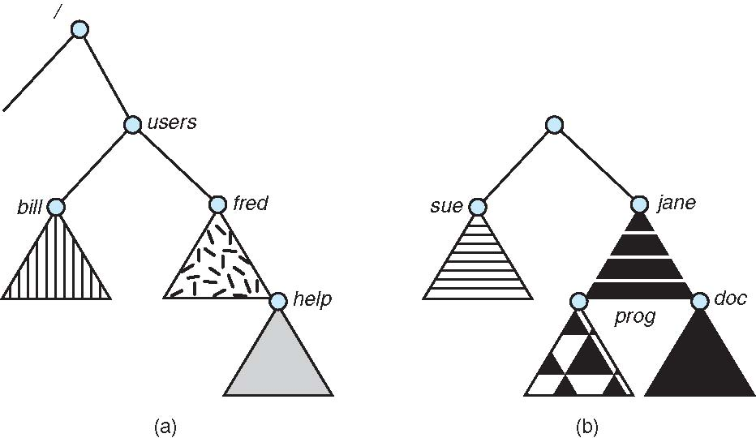
(a) Existing. (b) Unmounted Partition

Slide 33

Mount Point

Slide 34
File Sharing
Sharing of files on multi-user systems is desirable
Sharing may be done through a protection scheme
On distributed systems, files may be shared across a network
Network File System (NFS) is a common distributed file-sharing method

Slide 35
File Sharing – Multiple Users
User IDs identify users, allowing permissions and protections to be per-user
Group IDs allow users to be in groups, permitting group access rights

Slide 36
File Sharing – Remote File Systems
Uses networking to allow file system access between systems
  Manually via programs like FTP
  Automatically, seamlessly using distributed file systems
  Semi automatically via the world wide web
Client-server model allows clients to mount remote file systems from servers
  Server can serve multiple clients
  Client and user-on-client identification is insecure or complicated
  NFS is standard UNIX client-server file sharing protocol
  CIFS(common Internet File System) is standard Windows protocol
  Standard operating system file calls are translated into remote calls
Distributed Information Systems (distributed naming services) such as LDAP(Lightweight Directory Access Protocol), DNS, NIS, Active Directory implement unified access to information needed for remote computing

Slide 37
File Sharing – Failure Modes
Remote file systems add new failure modes, due to network failure, server failure
Recovery from failure can involve state information about status of each remote request
Stateless protocols such as NFS include all information in each request, allowing easy recovery but less security

Slide 38
Protection
File owner/creator should be able to control:
  what can be done
  by whom
Types of access
  Read
  Write
  Execute
  Append
  Delete
  List

Slide 39
Access Lists and Groups
Mode of access: read, write, execute
Three classes of users
RWX
a) owner access 7 ⇒ 1 1 1
RWX
b) group access 6 ⇒ 1 1 0
RWX
c) public access 1 ⇒ 0 0 1
Ask manager to create a group (unique name), say G, and add some users to the group.
For a particular file (say game) or subdirectory, define an appropriate access.
owner
group
public
chmod
761
game
Attach a group to a file
chgrp G game

Slide 40

Windows XP Access-control List Management

Slide 41
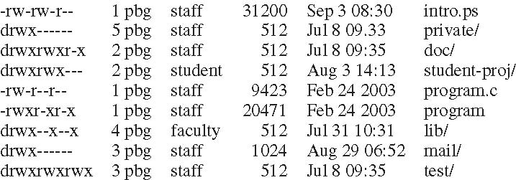
A Sample UNIX Directory Listing

Slide 42
End of Chapter 10

